Slide 1
Bachelor of Accounting (BAcc) –
UTS Business School

Slide 2
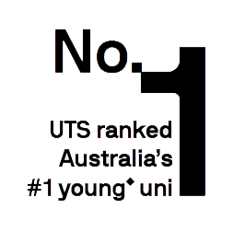
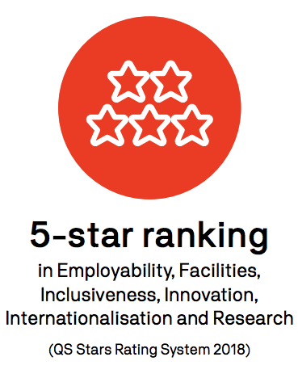
is world class
UTS
Association to Advance Collegiate Schools of Business
100%
of UTS research benchmarked at world standard or above
(2018 Excellence in Research for Australia evaluation)
#5 in Australia
for graduate outcomes (92.5% of students
employed full-time 3
years after grad)
(2019 Graduate Outcomes
Survey)

Slide 3
Study Business where business happens
Over 200 multinational corporations, or over 60% of those operating in Australia, are headquartered in Sydney
Australia’s tech startup capital - Over 60% of all startups are located in Sydney, identified as a top 20 innovative city nexus. Ultimo, where UTS sits, has the highest concentration of
startups of any suburb in Australia
95% of international banks operating in Australia, including 18 of the world’s 25 largest banks, are headquartered
in Sydney

Slide 4
why study accounting?
Accounting graduates with good academic qualifications
and if coupled with industrial experience are:
In high demand
Are well rewarded
Have international recognised qualifications

Slide 5
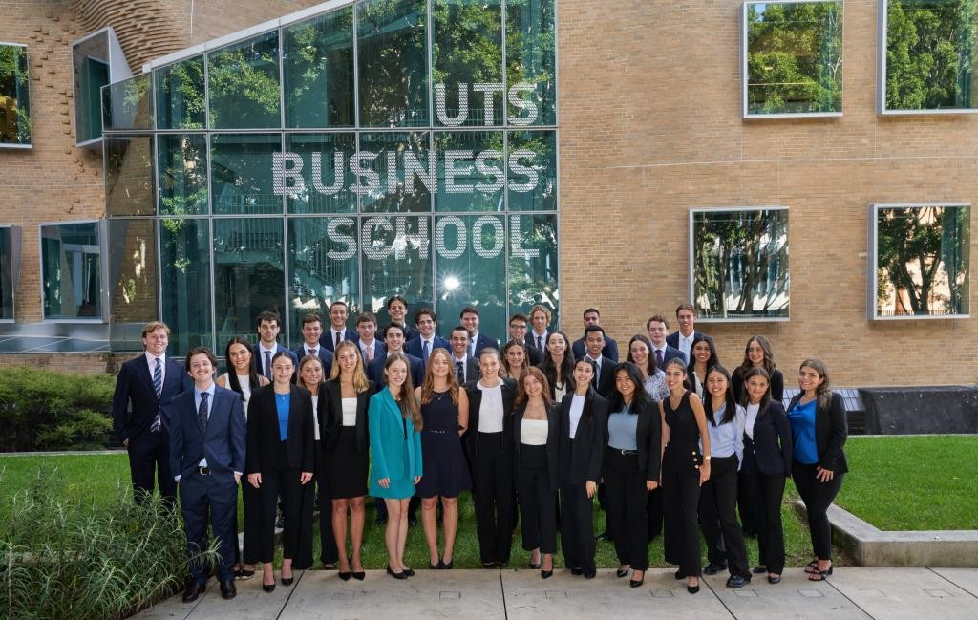
BAcc
Co-op program in partnership with major employers
Intensive program includes 2 x semester-length internships with sponsor organisations
Flexible course structure
Special application process includes interview
generous scholarship up to
$54 000
over 3 years

Slide 6
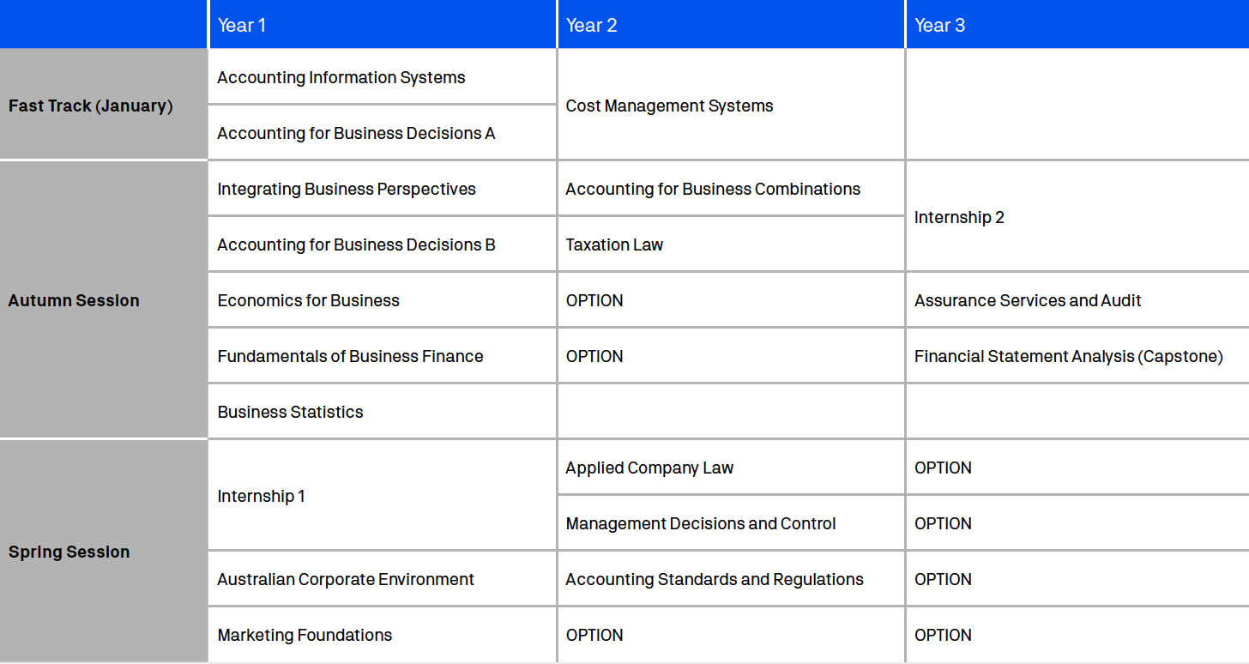
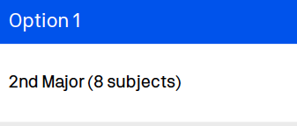
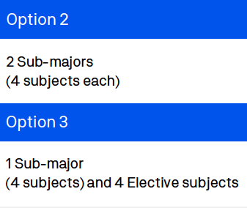
Course Structure
3 options to
finish your degree:

Slide 7
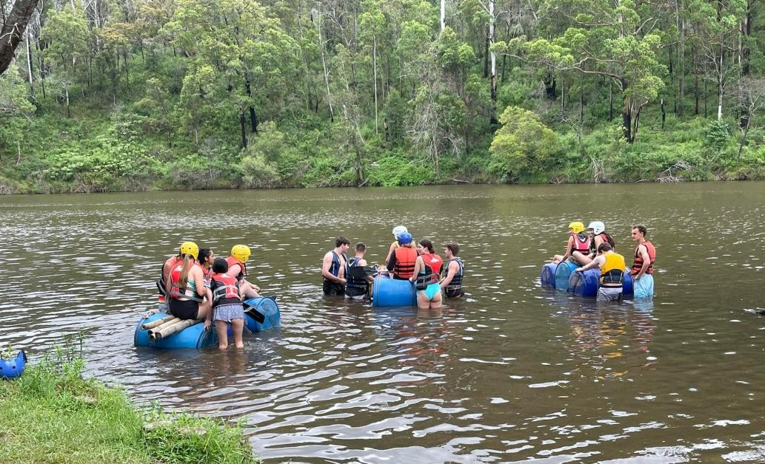
Annual Camps
Orientation Camp for 1st Years
Development Camp for 2nd Years
Leadership Bootcamp for 3rd Years
Hard work combined with heaps of fun!

Slide 8
Global Exchange
After Covid, Global Exchange allows students to study overseas for 1 semester at a UTS partner university in Asia, Europe or the Americas.
With 248 exchange agreements with partners in 50 countries and territories, UTS has one of the largest international exchange programs in Australia.

Slide 10
Employer involvement
Visits to workplaces
Function nights with senior managers
Guest lectures
Recruitment presentations
Representatives oversee course policy and direction

Slide 11
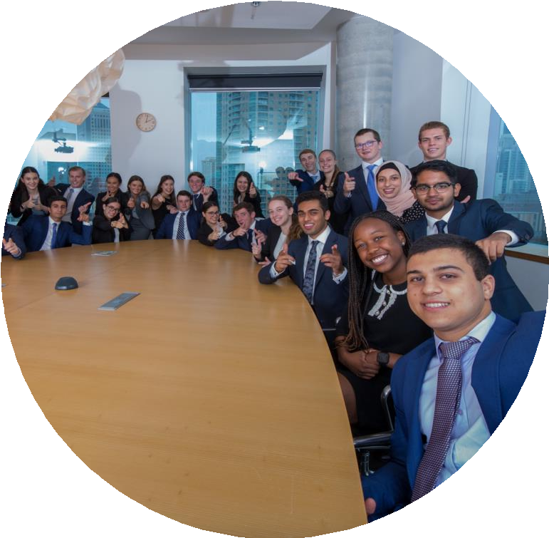
Career Prospects
Employers sponsor the program to recruit
top-calibre graduates
Job offers made at the start of third year
A year of full-time work strengthens your career prospects
95 % historic employment rate

Slide 12
Friendships & Fraternity
Not lost in the big crowd at university
Study and socialise together
Start every year with a camp
Close group of approx. 30 students with similar attributes & interests
Fast track periods

Slide 13
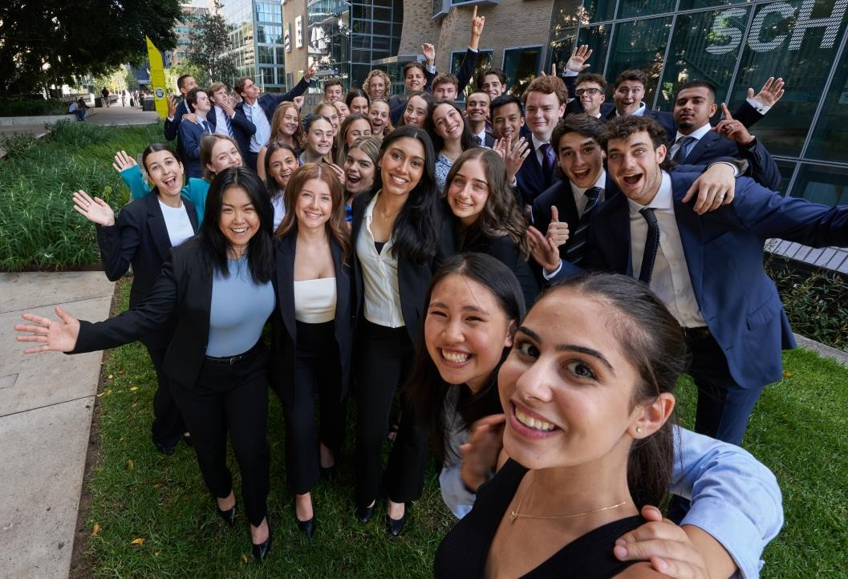
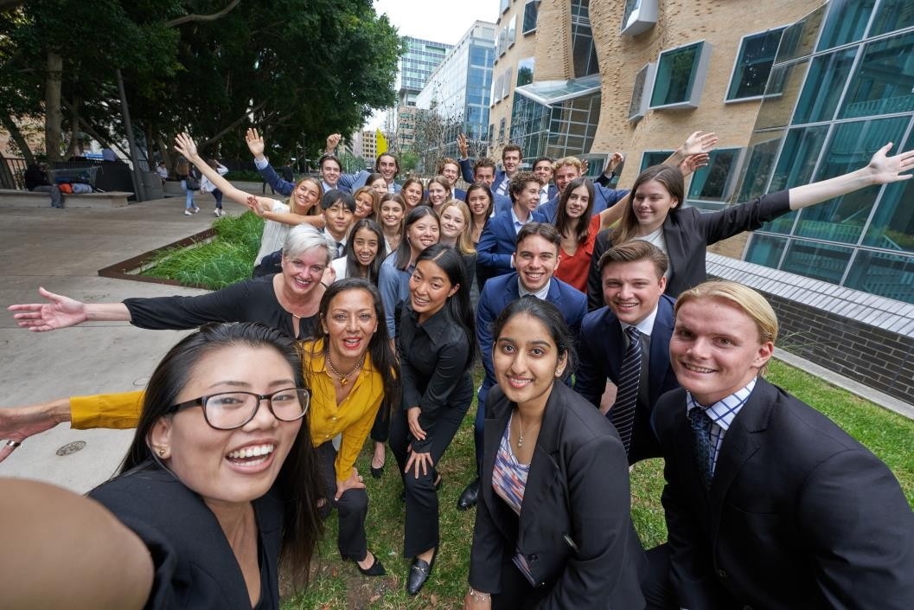
We’ve got your
BAcc

Slide 14
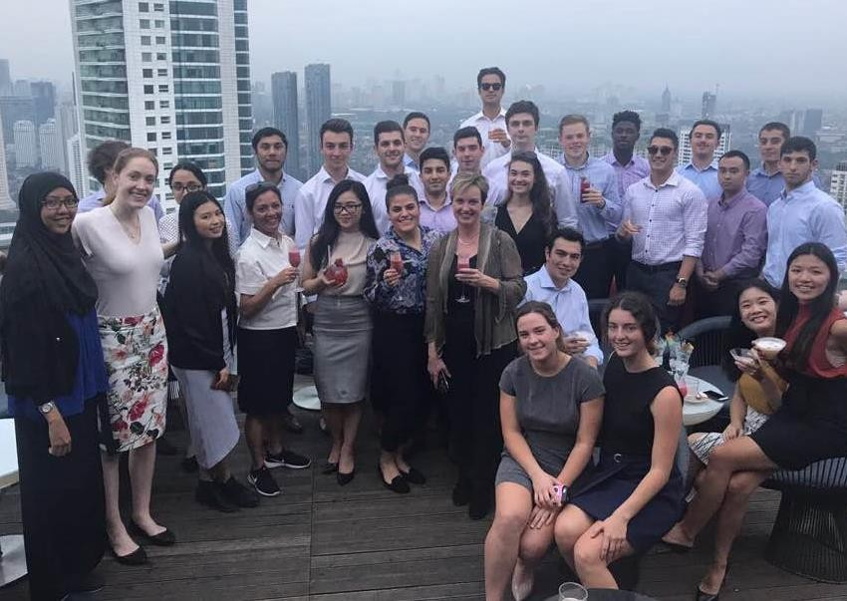
2nd Year Jakarta trip

Slide 15
When we look at your application, we’re
looking for:
Here’s how you get in
A passion for business and a genuine desire to pursue an
accounting-based career
People-centric skills, including communication,
interpersonal and teamwork capabilities, as well as the capacity for analytical thinking and effective problem solving
Engagement beyond the classroom
Academic ability

Slide 16
How to apply
Nominate the BAcc as one of your preferences in UAC
Complete the online application by one of the
cut-off dates below:
Round 1: Friday 19 May 2023
Round 2: Friday 13 October 2023
Successful applicants will be invited to participate in an interview in November 2023
Successful interviewees will be made a conditional offer subject to their ATAR

Slide 17
Find out
more
Register for the Info Evening on 10 May Carin.Alberts@uts.edu.au
Send us an email
coop.ed@uts.edu.au
Ask questions on Facebook
@UTSBusiness

Slide 18
Course Structure – Health
Health Study Options
Nursing Accelerated Nursing Midwifery Sport and Exercise Science Sport and Exercise Management Health Science Women's and Children's Health Other online options

Slide 19
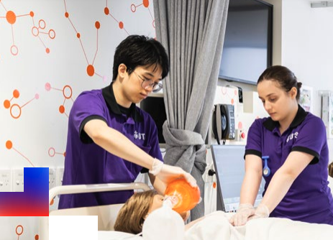

Slide 20
Benefits of UTS
Orientation Camp for 1st Years
Development Camp for 2nd Years
Leadership Bootcamp for 3rd Years
Hard work combined with heaps of fun!

Slide 21
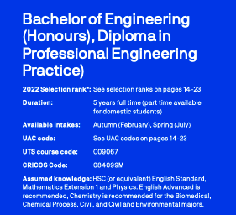
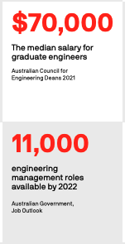
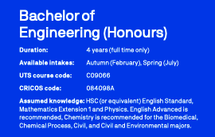
Course Structure – Engineering

Slide 22
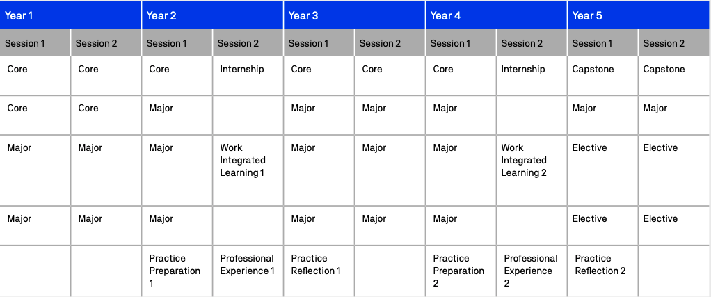
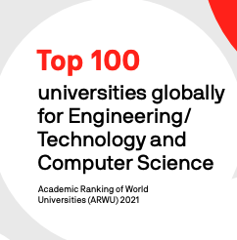
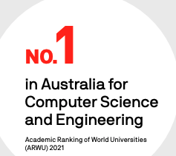

Slide 23
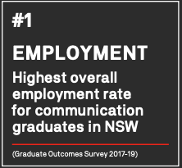
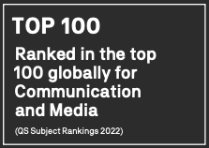
Course Structure – Media Arts and Production
3 options to
finish your degree:

Slide 24
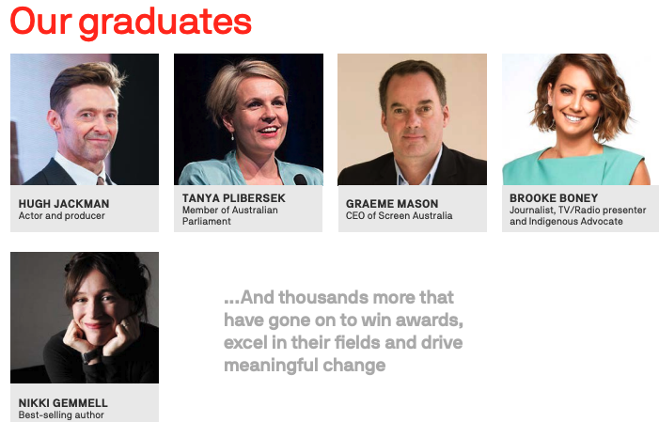

Slide 25
Entry Options
UTS Early Entry Program UTS Engineering and IT Early Entry Program – Edge Year 12 subject scheme Educational access schemes Elite athletes and performers Specific study area schemes Schools Recommendation Scheme
Dates begin anywhere from May, Please research individually to locate more specific dates.

Slide 26
Thank you!

